Slide 1
A digital-first model of diabetes care
Joseph Cafazzo PhD PEng
Shivani Goyal PhD
Executive Director, University Health Network
Wolfond Chair in Digital Health
Associate Professor, University of Toronto
Lead, Strategy and Research, eHealth Innovation, University Health Network
Assistant Professor, University of Toronto

Slide 2
Bant logo + tag line
Same org. logos as banner

Slide 3
A digital-first model of diabetes care
Access to our diabetes data - both clinically and from our devices - in a form that is actionable and friction-less
Access to more timely care - via a virtual visit or otherwise - our choice - challenge the system for digitally-mediated access to the most appropriate care provider
Transparency through eConsent - we are the custodians of our own data - the ability to donate our data for research and care provision.
Notes:
Do we need to number the projects somehow?

Slide 4
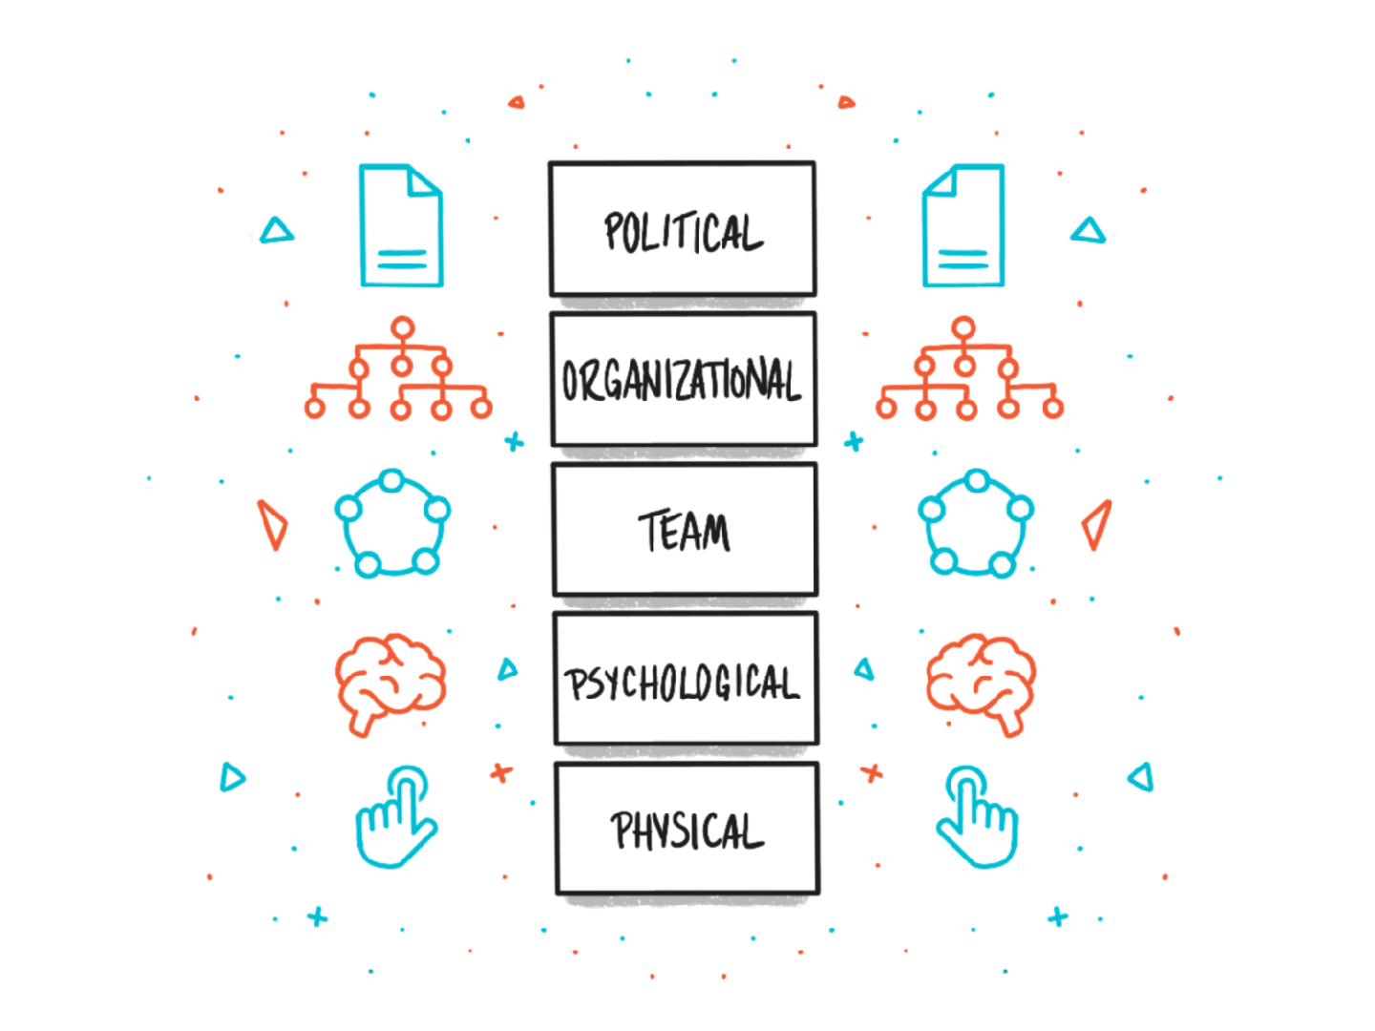
the human-tech ladder

Slide 5
Engaged with MOHLTC on Project Spark
Engaged with device manufacturers, JDRF and HCT
Engaged with endocrinologists, family physicians, diabetes educators, and health coaches
Engaged with people living with diabetes

