Slide 1
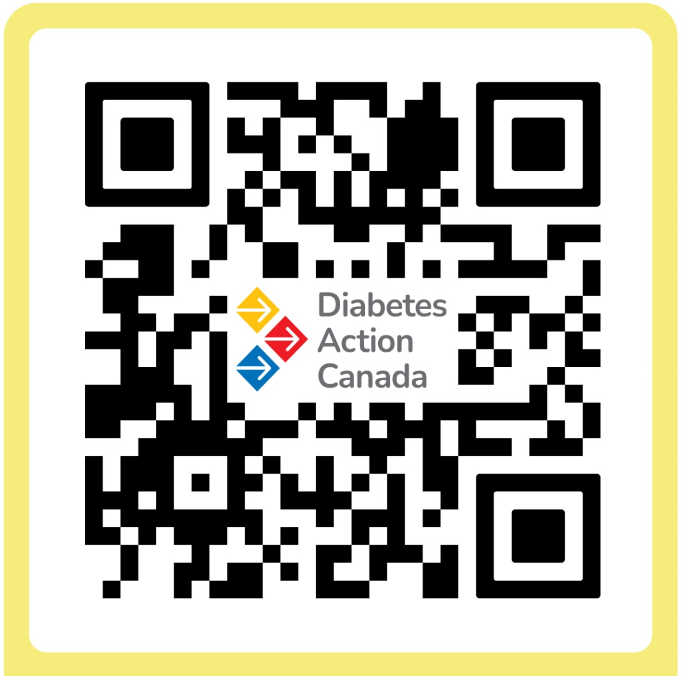
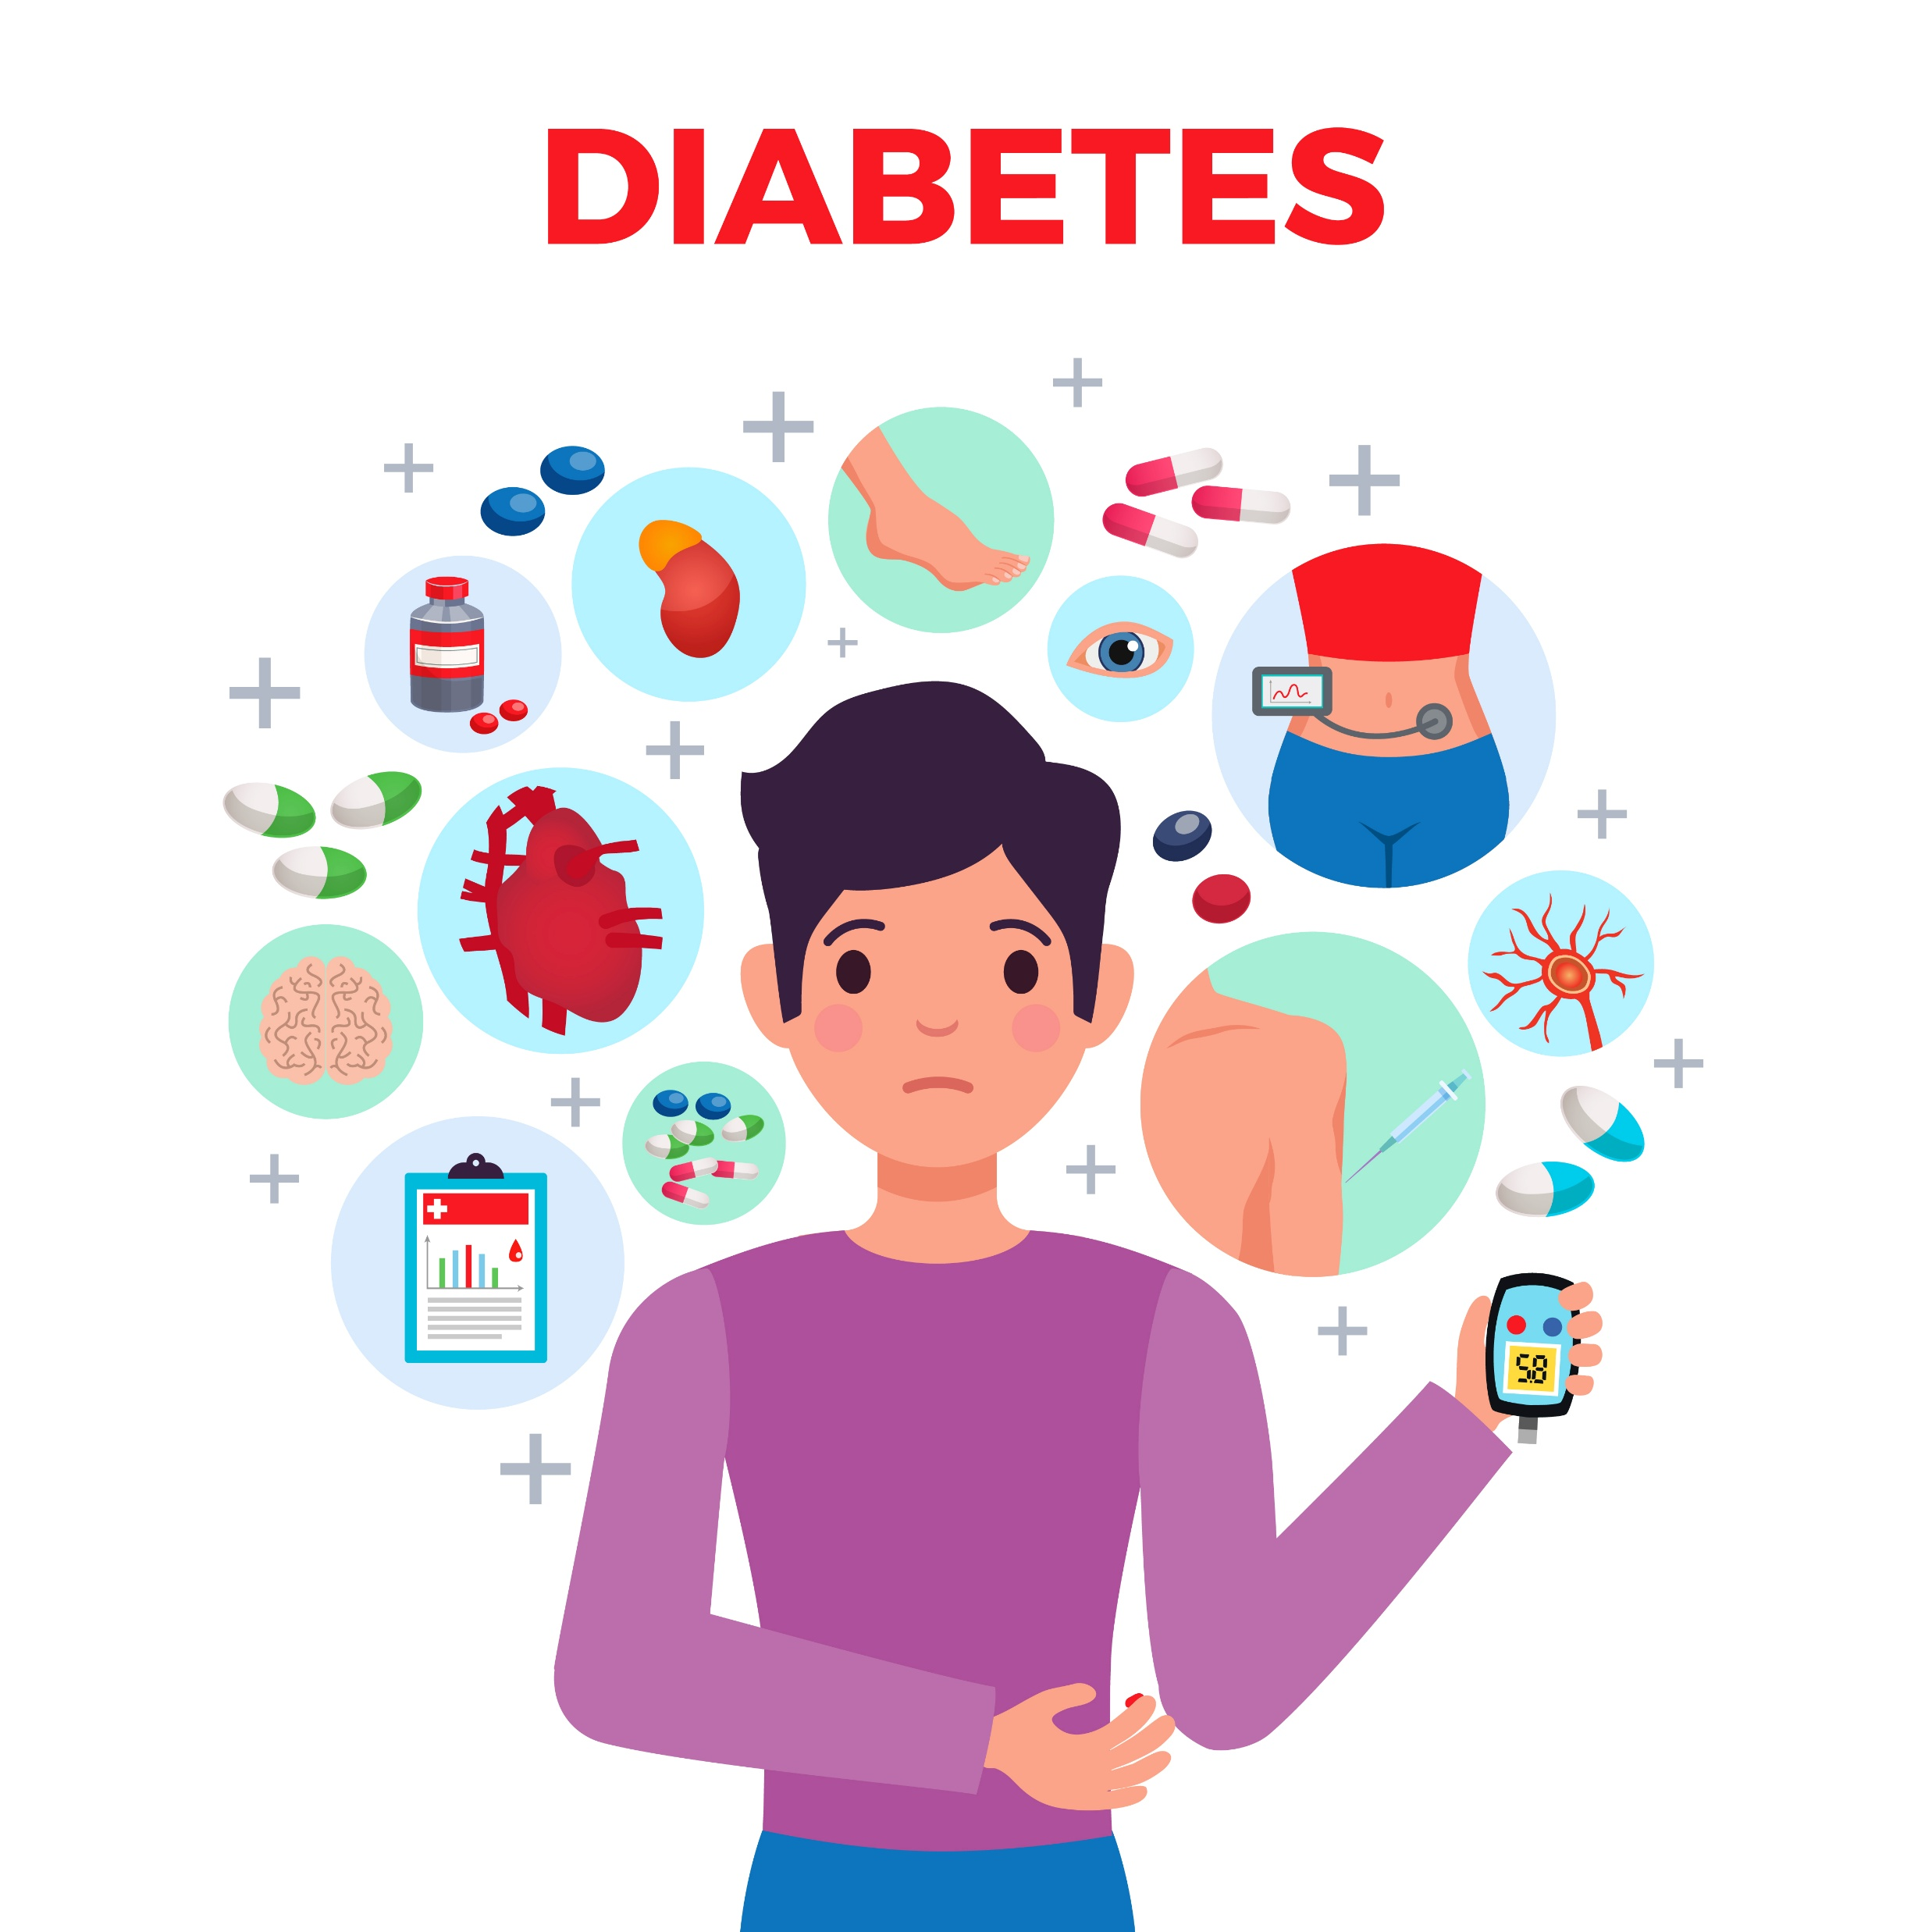
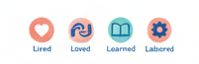
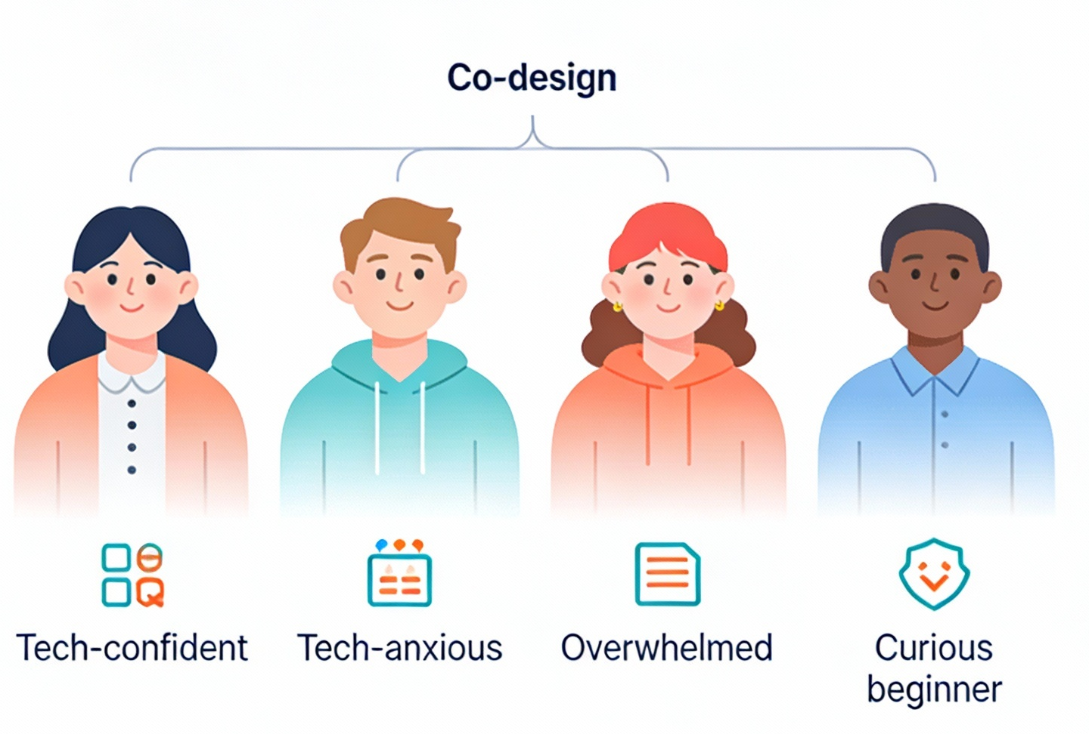
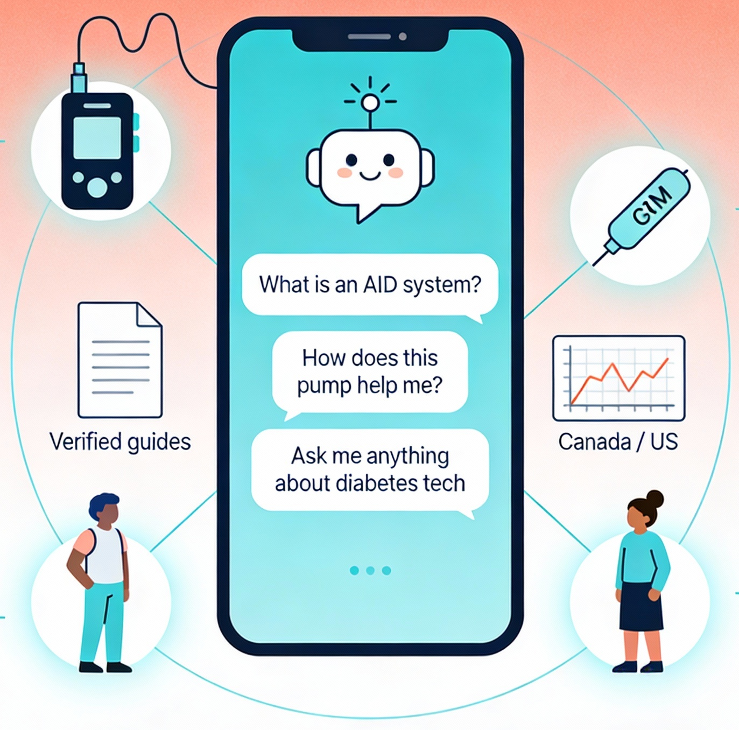

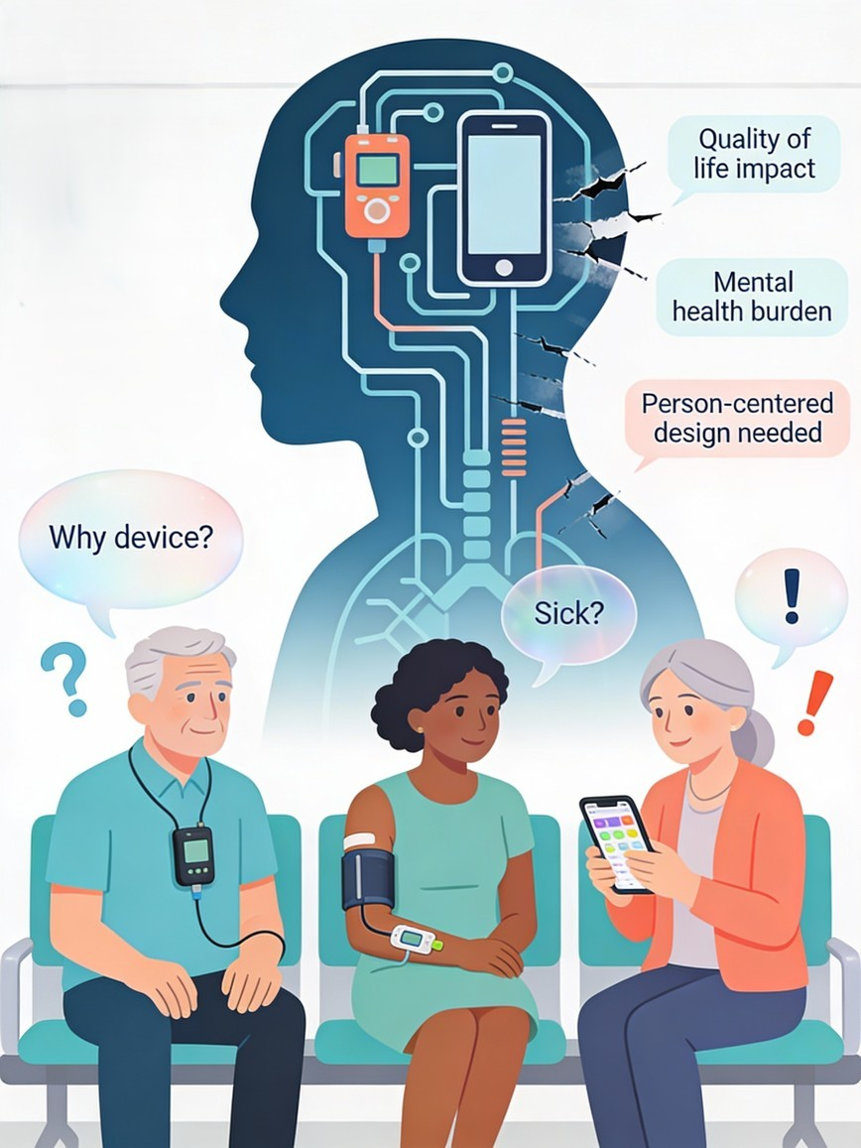
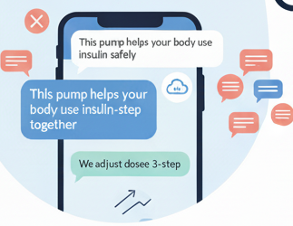


Pick My Pump: Co-designing an Artificial Intelligence Chatbot Navigator to Tackle Diabetes Technology-Associated Stigma in the Diabetes Community
Md. Najeeb Ashraf,^{1,2} Amanda Knight¹
¹Research to Action Fellow, Diabetes Action Canada, Toronto;
²SciVoc Consulting Inc., Toronto, Canada
Scan Me
Diabetes technology-associated stigma (i.e., use of insulin pumps, AID systems [including DIY] is commonly observed in the diabetes community.
AIM: To reduce diabetes technology-associated stigma by creating an AI-powered pump and AID chatbot navigator to ask sensitive questions, fostering confident shared decision-making.
What patients and caregivers usually feel
Built with T1D lived (over 4 decades) and loved (parent of a child with over 5 years) experience
Expected Outcomes
DAC led co-designing sessions (>2 dozen people)
Ask me anything about insulin pumps, CGMs, AID, and DIY systems across US and Canada.
Empathetic Support
Not for Me
Confused
Fearful
Shame &
Guilt
AID Chatbot Navigator
Non-judgmental and confidential
conversations
Too complicated
Blame &
Judgement
Tech feels inaccessible
Boosting confidence
Stigma shapes technology choices (AID or DIY or none)
Plain language (Grade 3-5) and Verified AID guides
Encouraging, empowering and identification of stigma-related themes
Education and Guidance
Access to relevant and accurate information
Key Takeaway
Stigma extends beyond clinics into peer and tech support spaces. Patients and caregiver inputs are instrumental to make the AI Chatbot relatable, prioritize anonymity, plain language, and strict boundaries on the tool functionalities. We will continue future testing and refining the tool with user inputs (patients, caregivers and healthcare) and interpret emerging themes.
Abbreviations: AID, Automated Insulin Delivery; CGM, Continuous Glucose Monitoring; DAC, Diabetes Action Canada; DIY, Do-It-Yourself; T1D, Type 1 Diabetes
Acknowledgments: We acknowledge all patients and caregivers who participated in the co-design sessions, members of the DAC research-to-action fellowship group, Linxi Mytkolli, Patient Engagement Director, DAC, and Marissa Town, Clinical Director, CwD, for their support of this project.

